Slide 1
National Outcome Forecast Analysis
South Africa
Analysis prepared by Charles Rethman

Slide 2
Reasons for the NOFA
South Africa experienced its worst drought in 23 years;
Poor crop performance due to the drought forced massively increased imports;
Concurrently, commodity markets have slowed and the currency (Rand; ZAR) is weak;
Consequently, food prices have soared in local terms

Slide 3
Analysis Process
This assessment was conducted to try answer this question.
It aims to gain some insight on a broad, national scale into what the near-future consequences of drought and economic turmoil might be for households.
It is a desk study. It is indicative. It draws heavily on secondary sources and is liberally sprinkled with assumptions. Many of the sources and assumptions need to be tested with new and better data.
Notes:
The written report will highlight many of these assumptions which cannot be covered in this presentation.

Slide 4
Analysis Process
Uses the same standard livelihoods-based approach that is used in other SADC member states. Steps:
Make use of existing baselines and data (14 LZs)
Extrapolate the existing data to include other similar (open access tenure) LZs
Construct baselines using secondary sources for two other livelihood types:
Farm workers
The urban poor

Slide 5
Analysis Process
Uses the same standard livelihoods-based approach that is used in other SADC member states. Steps:
Hazard determination - analyse rural productive systems to determine local problem specifications
Review economic data to determine reasonable price estimates and future price scenarios
The issue of social grants. They make an overwhelming difference, so what about those few people who have no access to them?

Slide 6
Baselines
Open access areas without existing baselines
Group LZs into three Livelihood Types:
Predominantly livestock-based
Predominantly cropping-based
A mixture of the two .

Slide 7
Baselines
Open access areas without existing baselines
Livelihood strategies were derived by aggregating the data from the same Livelihood Types:
Predominantly livestock-based
Predominantly cropping-based
A mixture of the two .

Slide 8
Baselines
Example of the mixed baseline (ZA2XX)

Slide 9
Farm workers & Urban Poor
Information was pieced together from survey data, mostly the Western Cape Farm Workers’ Conditions survey and the National Income Dynamics Survey
Wealth groups replaced with categories:
Farm workers: casuals, temporary workers and full-time employees
Urban: quintiles (we only looked at the bottom four)

Slide 10
Farm workers and Urban Poor
Example of the Farm Workers

Slide 11
Farm workers and Urban Poor
Example of the Urban Poor

Slide 12
The Drought
To determine the extent of the impact of the drought, we looked at many sources:
Standard Precipitation Indices (SPI) from ARC ;
Normalised Differential Vegetation Indices;
Vegetation Condition Index (VCI)

Slide 13
SPI
Notes:
“The Standardized Precipitation Index (SPI - McKee et al., 1993) was developed to monitor the occurrence of droughts from rainfall data. The index quantifies precipitation deficits on different time scales and therefore also drought severity. It pro- vides an indication of rainfall conditions per quaternary catchment (in this case) based on the historical distribution of rainfall.” – UMLINDI – The Watchman, Issue 2016-1.

Slide 14
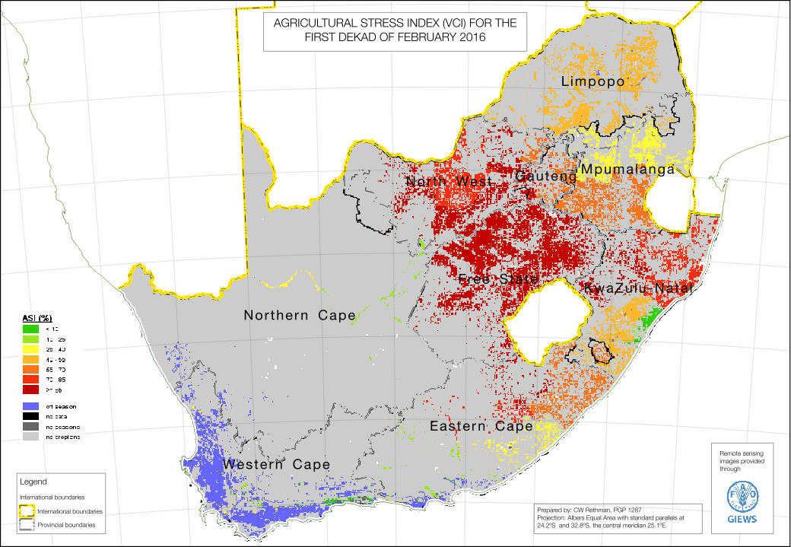
Agricultural Stress Index
Notes:
This image showed the development of the season just after the rains got underway in January.
The ASI is good for crop farming conditions but lacking for livestock areas.

Slide 15
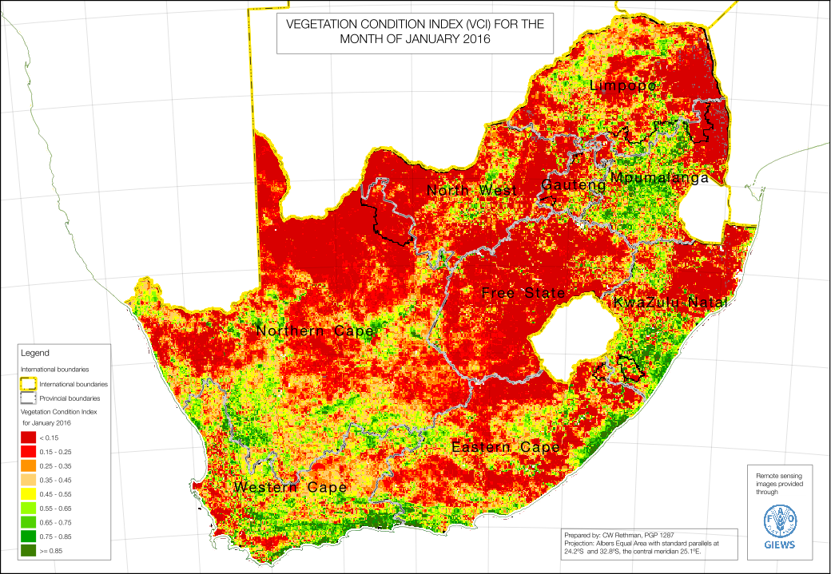
Vegetation Condition Index
Notes:
The analyst decided to use the image from January, as it shows the condition of the vegetation by the time the rains actually started in January. By then, it was too late for much of the crop farming areas and the impact on the livestock rangelands is visible too. However, some of the impact of the summer rains in January does also come through as well. This image therefore also distinguishes between those areas that received some summer rainfall and those that did not.
Previous VCI images (e.g. November and December) show a much worse situation.

Slide 16
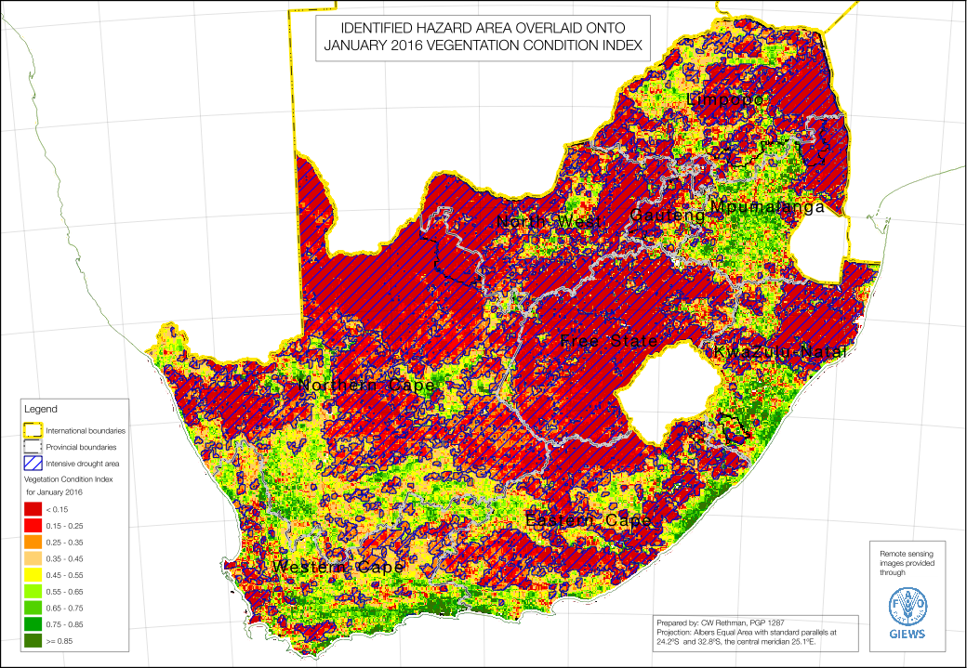
Vegetation Condition Index & Drought Hazard Area
Notes:
The ‘reddest areas’ (VCI < 0.35) were picked out and digitised (buffered for aggregation). These are presented as the cross-hatched area with the most intensive drought. The Hazard area was then used to determine problem specifications.

Slide 17
Problem Specifications
Crop estimates are provided by the CEC and they available data are detailed for commercial farming (exclusive access tenure).
However, detail in non-commercial crop farming areas is lacking.
To geographically disaggregate of crop data and obtain a problem spec the analyst overlaid the hazard are onto the agricultural regions.
This help quantify Prob Specs for basic crop groups, e.g. cereals, legumes, etc.

Slide 18
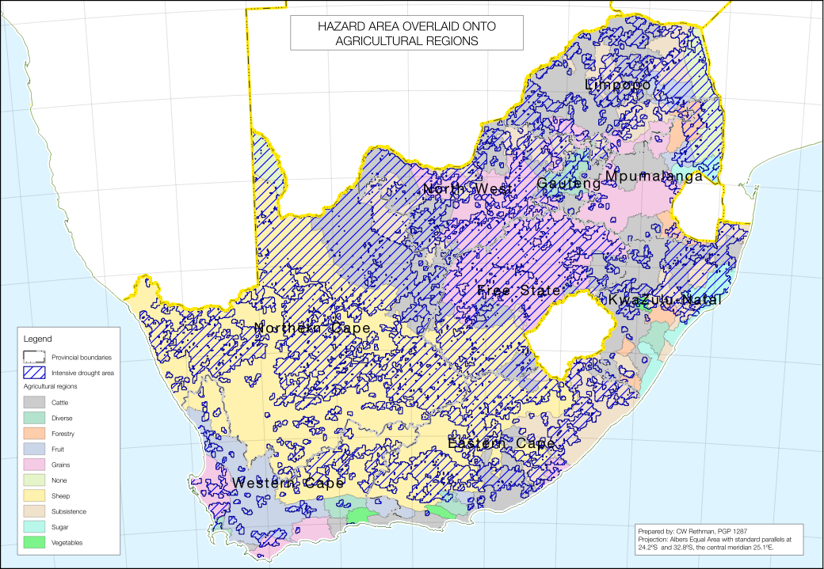
Hazard Area & Farming Regions
Notes:
The ‘reddest areas’ (VCI < 0.35) were picked out and digitised (buffered for aggregation). These are presented as the cross-hatched area with the most intensive drought. The Hazard area was then used to determine problem specifications.

Slide 19
Example Problem Specs for Grains
province | ag_type | ha_total | pspec_cec | hazard | ha_local | pc_ha_affected | pspec_local
--------------+-------------+----------+-----------+---------+----------+----------------+-------------
All provinces | Subsistence | 13198889 | 62% | drought | 7884053 | 60% | 30%
All provinces | Subsistence | 13198889 | 62% | normal | 5314836 | 40% | 110%
Eastern Cape | Grains | 288584 | 54% | drought | 139844 | 48% | 30%
Eastern Cape | Grains | 288584 | 54% | normal | 148740 | 52% | 77%
Free State | Grains | 7987746 | 42% | drought | 6804745 | 85% | 36%
Free State | Grains | 7987746 | 42% | normal | 1183001 | 15% | 77%
Gauteng | Grains | 271004 | 56% | drought | 137155 | 51% | 36%
Gauteng | Grains | 271004 | 56% | normal | 133849 | 49% | 77%
KwaZulu-Natal | Grains | 492 | 75% | drought | 20 | 4% | 27%
KwaZulu-Natal | Grains | 492 | 75% | normal | 472 | 96% | 77%
Limpopo | Grains | 1023062 | 113% | drought | 285091 | 28% | 43%
Limpopo | Grains | 1023062 | 113% | normal | 737971 | 72% | 140%
Mpumalanga | Grains | 2974656 | 66% | drought | 287721 | 10% | 29%
Mpumalanga | Grains | 2974656 | 66% | normal | 2686935 | 90% | 70%
North West | Grains | 4640096 | 59% | drought | 3004416 | 65% | 49%
North West | Grains | 4640096 | 59% | normal | 1635680 | 35% | 77%
Northern Cape | Grains | 97 | 141% | drought | 88 | 91% | 135%
Northern Cape | Grains | 97 | 141% | normal | 9 | 9% | 200%
Western Cape | Grains | 2097713 | 167% | drought | 508228 | 24% | 64%
Western Cape | Grains | 2097713 | 167% | normal | 1589485 | 76% | 200%

Slide 20
Prices
Price trends for main household commodities were considered, example here is for maize meal
Notes:
The dotted line at the top show the expected prices for 2016 to 2017.
This graph factors in the recent jump in maize prices on the SAFEX (35% over the last year). There is a slight rise in price trends through the year, leading up to the harvest.

Slide 21
Social Grants
Two social grants in South Africa make a substantive difference for households’ consumption: the Child Grant and the Old Age Grant
The majority of poor rural households have access to these grants; it is reflected in the baselines
However, there is still a minority of households that do not receive these grants (do not qualify or exclusion error)
To manage this situation in the analysis, two ‘scenarios’ for social grants were used: receive and do not receive.

Slide 22
Thresholds in South Africa
In order to inform policy, the SAVAC has base its outcomes in terms of the poverty lines defined by Statistics South Africa’s Income-Expenditure Surveys. There are
Food Poverty Line
Lower Bound Poverty Line
Upper Bound Poverty Line
This is:
To enable comparison’s of SAVAC forecasts with other survey data;
To link the VA with the National Development Plan objectives – impact on policy
Food Poverty Line: SAVAC takes this as “survival threshold” although strictly it is not. It includes basket with a wide range of commodities and people could “survive” on a much smaller, cheaper set of commodities;
This is because we are concerned with inequality and living standards; it is unacceptable that people show only just survive.

Slide 23
Analysis
Examples of impact on household total income: Okahlamba open-access intense crops and livestock
Hazard-affected area, household receiving grants

Slide 24
Analysis
Examples of impact on household total income: Okahlamba open-access intense crops and livestock
Hazard-affected area, household not receiving grants
Grants have a huge impact!
Notes:
Food Poverty line is survival

Slide 25
Analysis
Examples of impact on household total income: farm workers
Hazard-affected area, household receiving grants
Notes:
Casual workers fall below the FPL and temporary workers are right on the FPL.

Slide 26
Analysis
Examples of impact on household total income: farm workers
Hazard-affected area, household not receiving grants
Notes:
Food Poverty line is survival

Slide 27
Analysis
Examples of impact on household total income: urban poor
Hazard not so significant, household receiving grants
Notes:
The urban poor do not include people living in prosperous suburbs or city apartments.

Slide 28
Analysis
Examples of impact on household total income: urban poor
Hazard not so significant, household not receiving grants
Notes:
Food Poverty line is survival

Slide 29
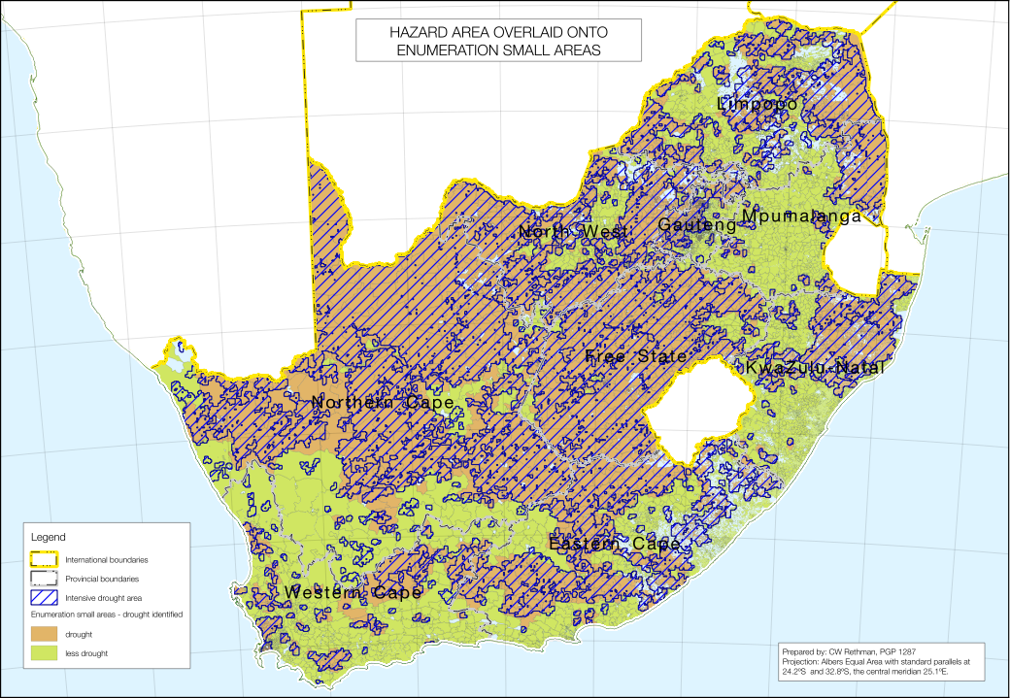
So how does it all add up?
The hazard and analysis can be overlaid onto the Enumeration small areas; populations and deficits can then be summed over the whole country

Slide 30
Food Consumption Deficit Totals
Province | Pop at Risk | Food Deficit Maize eq.
Eastern Cape | 588,606 | 61,104
Free State | 102,946 | 8,962
Gauteng | 1,766,923 | 129,689
KwaZulu-Natal | 336,226 | 34,668
Limpopo | 177,314 | 12,778
Mpumalanga | 709,691 | 52,600
North West | 352,955 | 26,087
Northern Cape | 357,777 | 37,900
Western Cape | 490,543 | 57,060
Grand Total | 4,882,981 | 420,848

Slide 31
Food Poverty Line Deficit Totals
Province | Pop at Risk | FPL Deficit
Eastern Cape | 588,606 | 1,074,977,708
Free State | 102,946 | 150,563,075
KwaZulu-Natal | 1,799,426 | 2,979,042,673
North West | 336,226 | 652,102,973
Northern Cape | 177,314 | 234,940,381
Western Cape | 709,691 | 864,660,857
Gauteng | 352,955 | 436,536,551
Mpumalanga | 357,777 | 671,195,776
Limpopo | 490,543 | 1,066,014,623
Grand Total | 4,915,484 | 8,130,034,617

Slide 32
Upper Bound Poverty Line Deficit Totals
Province | Pop at Risk | UBPL Deficit
Eastern Cape | 3,403,718 | 17,130,019,769
Free State | 506,271 | 2,366,277,220
KwaZulu-Natal | 6,029,906 | 34,011,923,331
North West | 1,801,186 | 9,365,714,569
Northern Cape | 534,993 | 3,046,323,683
Western Cape | 5,146,630 | 21,527,836,623
Gauteng | 2,348,543 | 9,988,422,398
Mpumalanga | 2,045,696 | 10,076,232,825
Limpopo | 3,488,656 | 16,873,295,770
Grand Total | 25,305,599 | 124,386,046,186

Slide 33
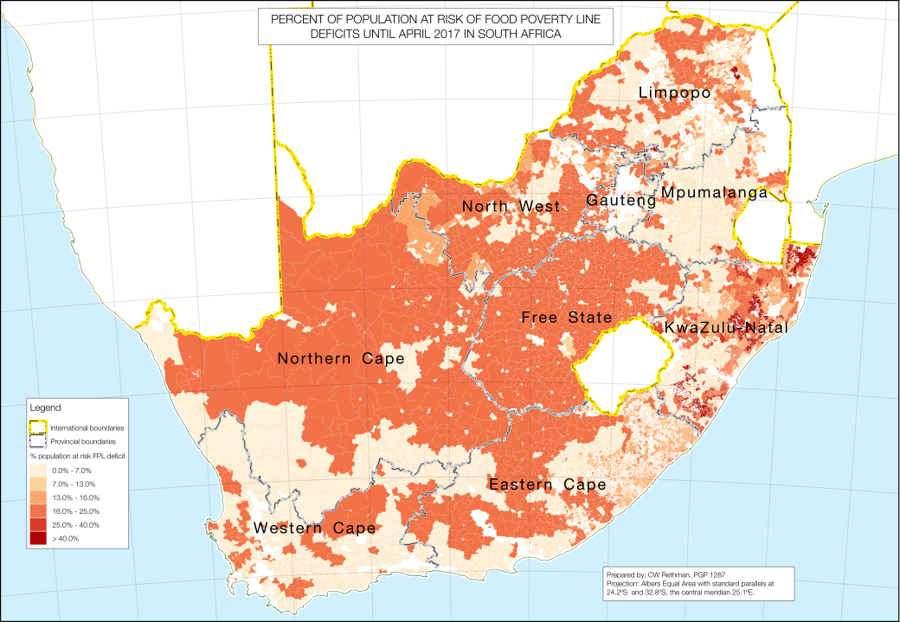
Outcomes

Slide 34
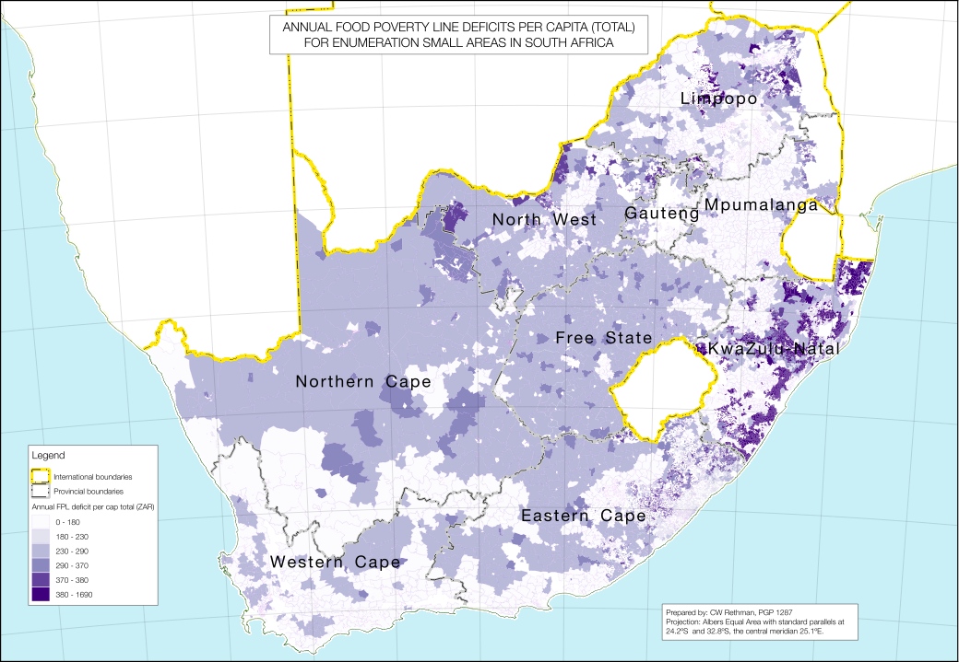
Outcomes

Slide 35
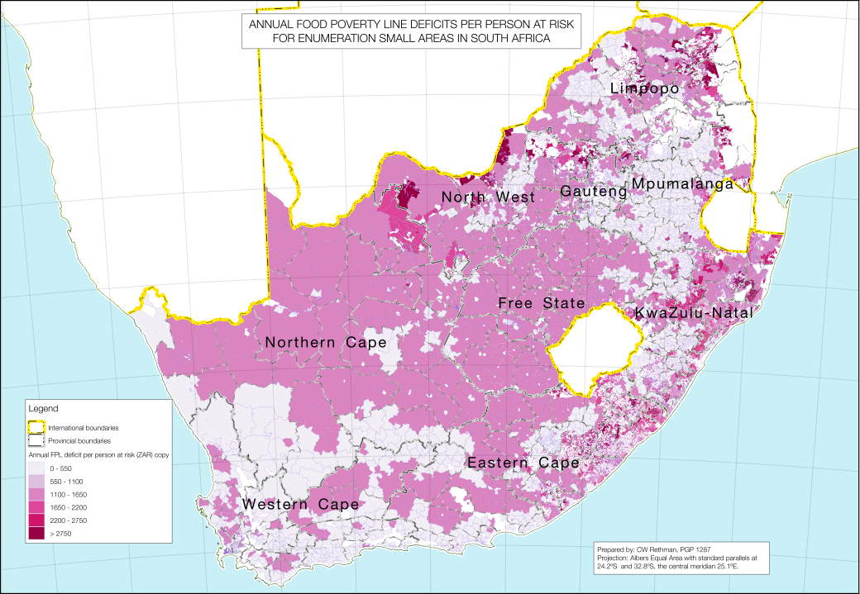
Outcomes

